Slide 1
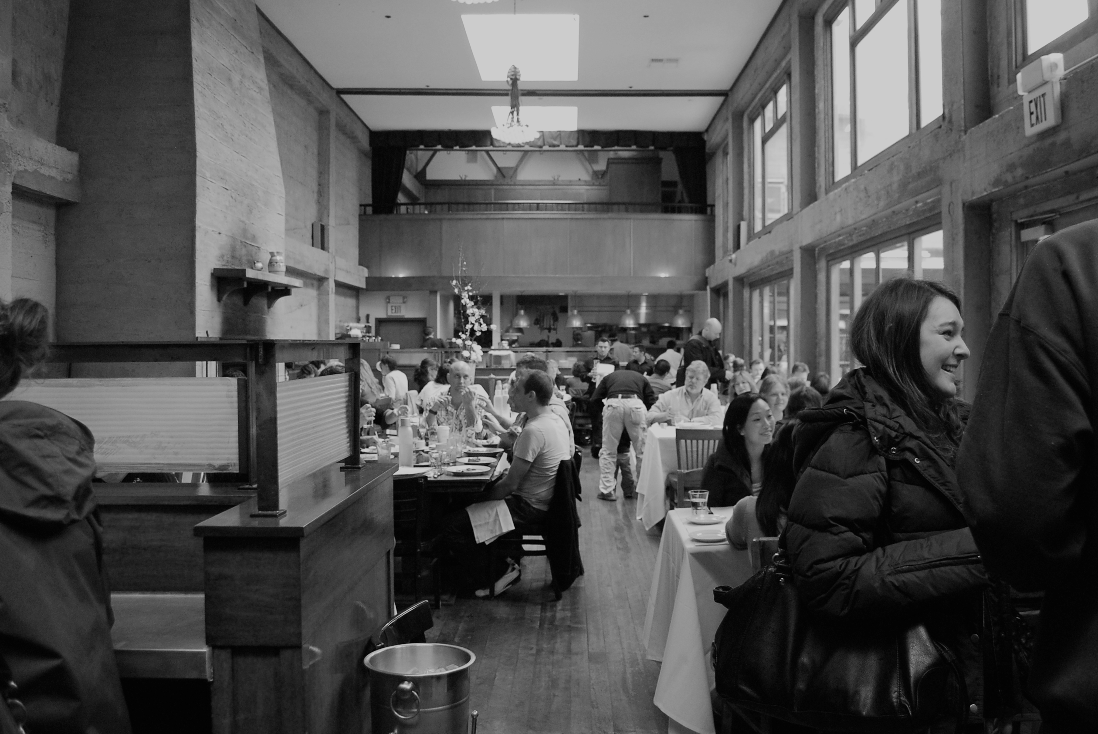
FastPass
Ramya Babu
Ben Geller
Audrey Leung
Henri Tilloy

Slide 2
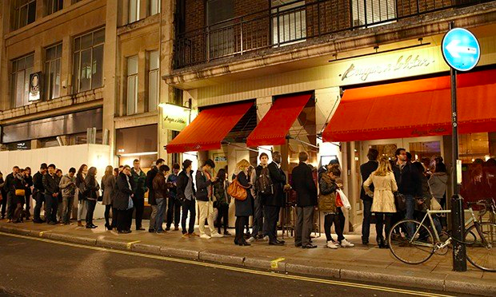
Job to be Done / Use Case Scenario
Don’t want to stand in line at a restaurant
Find a restaurant that fits taste, budget, and location preferences
Pay for someone else (a “queuer”) to stand in line in your place

Slide 3

What is FastPass?
Mobile app that allows user to:
Choose from a list of
restaurants with wait times > 30 minutes and “queuer” available to wait
Hire queuer
Notification and payment when table is ready

Slide 4


Target User and Needs
CUSTOMER
Josh Cormier
Working Professional
Age 28
QEUER
John Smith
Freelancer
Age 31
Single, no children, busy work schedule and social life
No time to cook and enjoys eating out
On a Friday or Saturday, he is eager to have a nicer, sit down dinner with his buddies and girlfriend
No patience for long line at a restaurant, and he is willing to pay to not have to stand in line.
Freelance designer
College educated
Single, no children, lots of side projects
Needs some extra money as he is saving up for more education to change careers
Usually free on evenings and weekends and wants to make some extra cash on the side
Notes:
FastPass matches restaurant goers with queuers who stand in line. The target user of the customer-facing app would be a busy working professional, single, and enjoys eating out with friends. He has has a steady disposable income and would be willing to pay to not have to stand in line at a restaurant with a long wait.
The target user for queuers would be a college educated freelancer who has a flexible schedule and could use some extra cash.

Slide 5
FastPass (customer-facing)
Prototype Link
Notes:
Now, let’s see how the design of the customer-facing FastPass app meets the needs of Josh. When he first launches the app, Josh is presented with a splash screen briefly describing the key benefits of the app. Then, the app prompts Josh to use GPS location tracking to provide the restaurants nearby.
The user can then browse a list of pre-populated restaurants that have estimated waits greater than 30 minutes and queuers nearby.
Upon selecting a restaurant, the user can view details about the menu, hours, and location. The user also gets a preview of the cost and the estimated wait time. In the MVP version, we are charging a flat fee for all queuers.
Once the user requests a queuer, they are matched with the nearest available queuer and need to complete the booking by filling out party information and payment details. Then, the user can track the queuer at the restaurant and is shown an estimated time at which the table will be ready.
When the table is almost ready, Josh will be contacted by the queuer via phone call. Once the Josh has acknowledged that his table is ready, the queuer will mark the transaction as completed, and the customer will receive a receipt.

Slide 6
Customer-Facing Prototype Screens

Slide 7
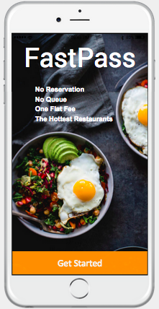
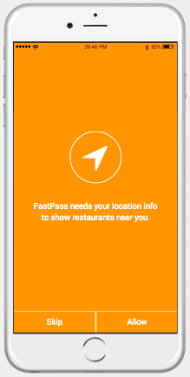
The “splash” screen upon launch gives the user a quick introduction about the key features and takeaways of FastPass. For the MVP, there is only one flat fee for booking restaurants.
Initially, the app would prompt the user for use of their GPS navigation in order to locate restaurants nearby.

Slide 8
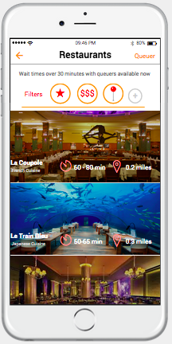
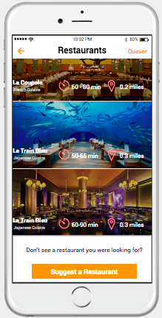
After setting the location settings, the app would display a limited list of pre-determined restaurants that are known to have long waits over 30 minutes and queuers nearby. The user can also filter for rating, price, location, etc. For each restaurant, initial information about distance and estimated wait times are displayed.
If the user does not see a restaurant that he/she was looking for, there is also an option to suggest a restaurant. Through customer demand, we would be able to determine which restaurants are worth listing in the app and at what times.

Slide 9
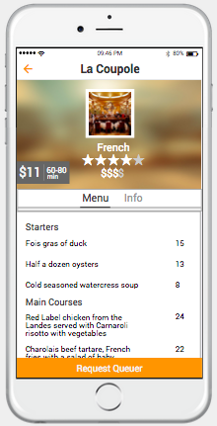
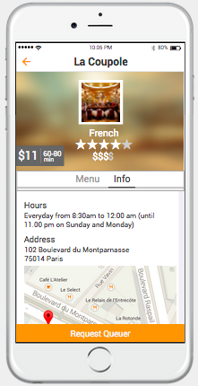
Upon selection of a restaurant, the user would be shown more details such as the menu as well as the price to book a queuer. The estimated wait time that was displayed on the home screen is also shown again.
The user can also view information about the restaurant such as hours, address, phone number, and website.
From here, the user can request a queuer to wait in line for them.

Slide 10
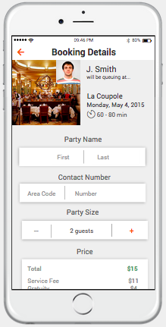
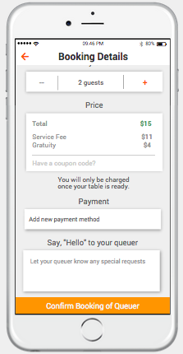
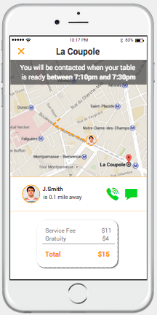
When the user chooses to request a queuer, they are matched with the nearest available queuer for the flat fee of $15. In order to complete the booking, the user needs to input their personal information, which can be saved for future uses by creating an account.
After confirming the booking, the user can track his/her order and the estimated time the table will be ready, so he/she can be prepared.

Slide 11
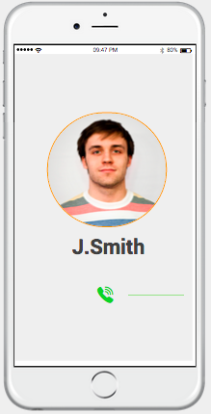
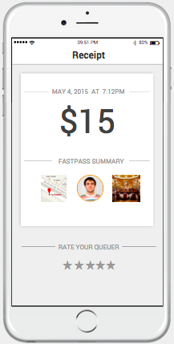
When the user is next in line or when the table is about to be ready, the queuer will contact the user by phone and text to notify him/her to be at the restaurant to claim the table.
When the customer has acknowledged the table was ready, the queuer will mark the transaction as completed, and the customer will pay the flat booking fee agreed upon, whether or not he/she actually claims the table or not. The queuer has an incentive to be honest and provide good service due to the rating system.

